Slide 1

PM Internship scheme
Registration Process

Slide 2

Go to the given URL https://pminternship.mca.gov.in/login/

Slide 3

Click on Youth Registration

Slide 4
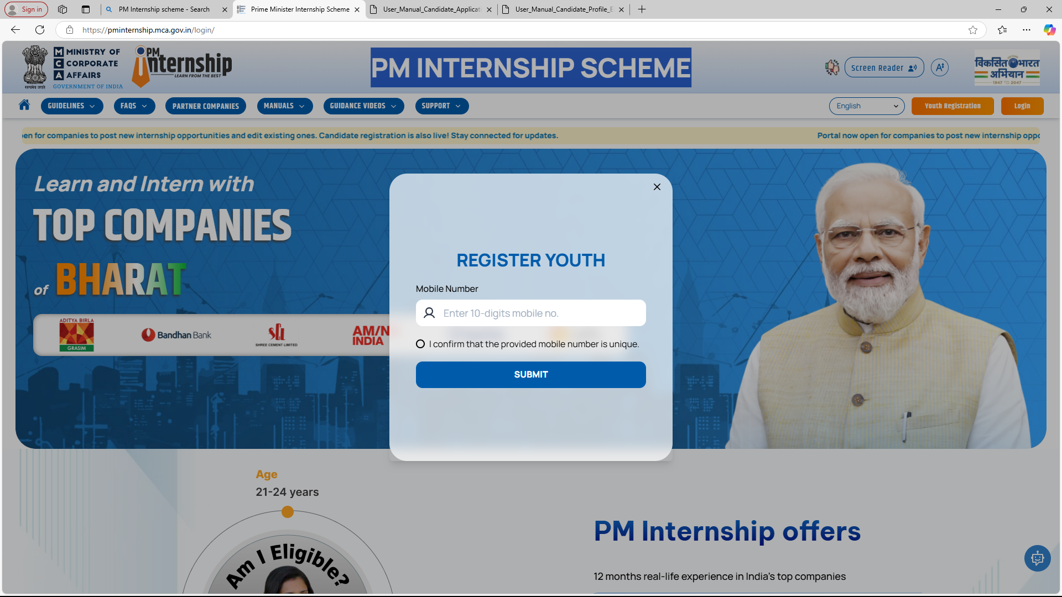
Enter 10 Digit Mobile Number

Slide 5
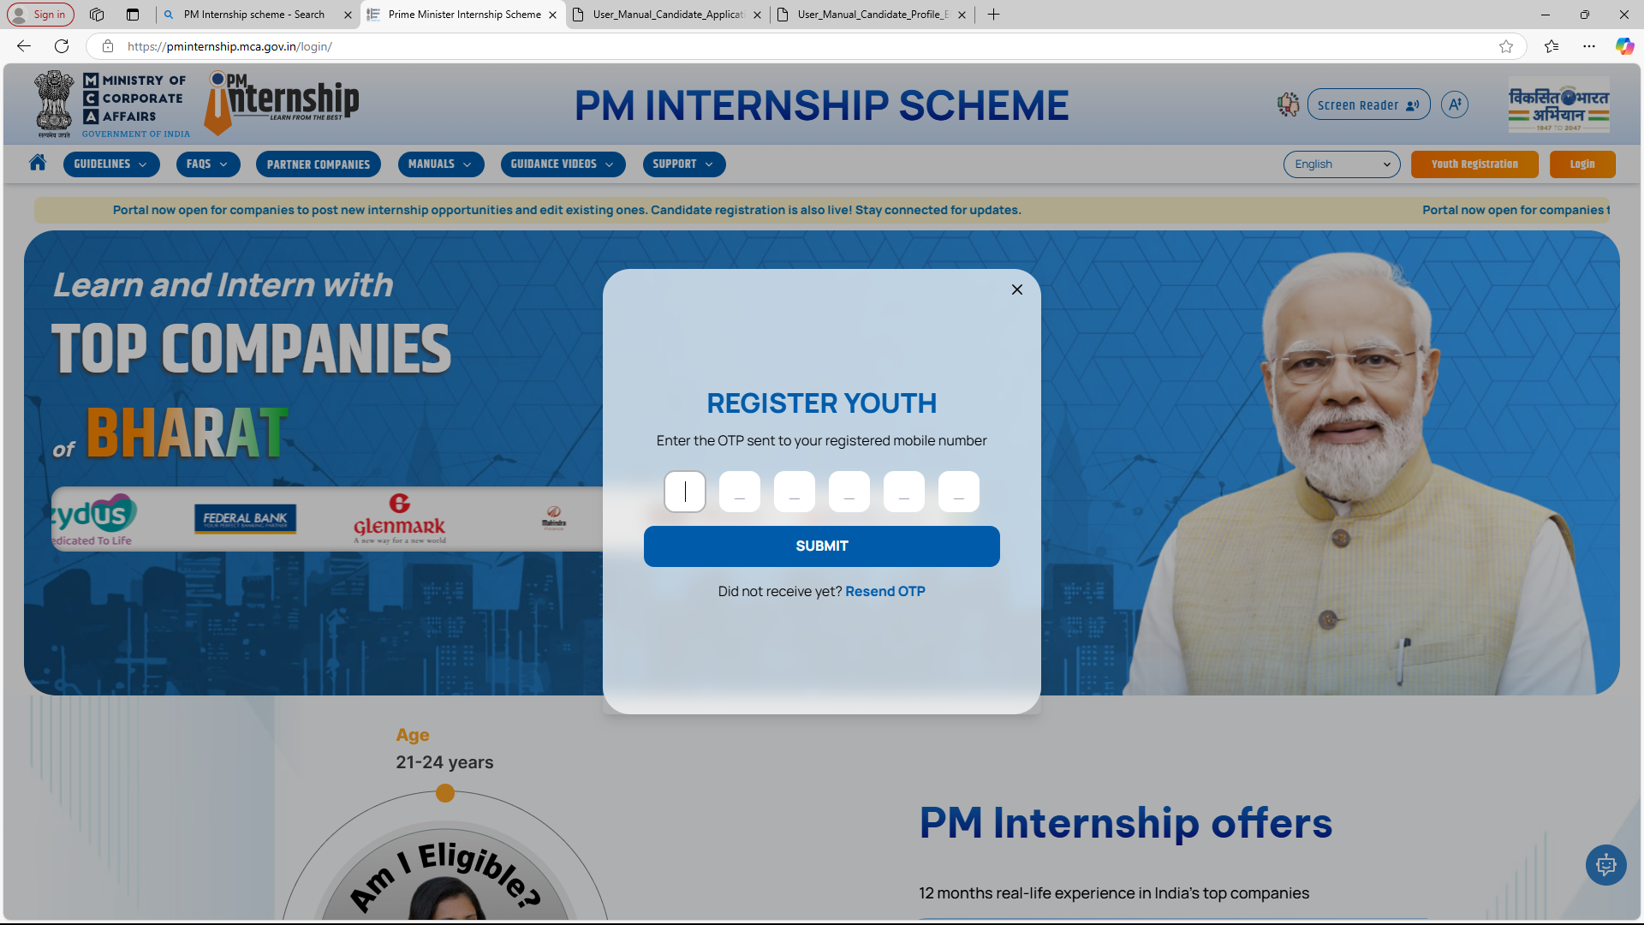
Enter OTP Received in your Number

Slide 6
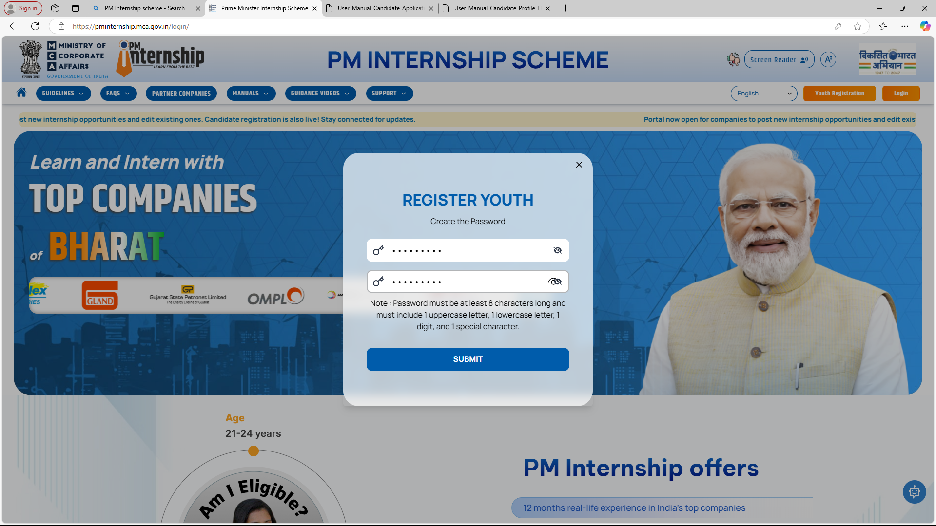
Create your Password and Submit

Slide 7
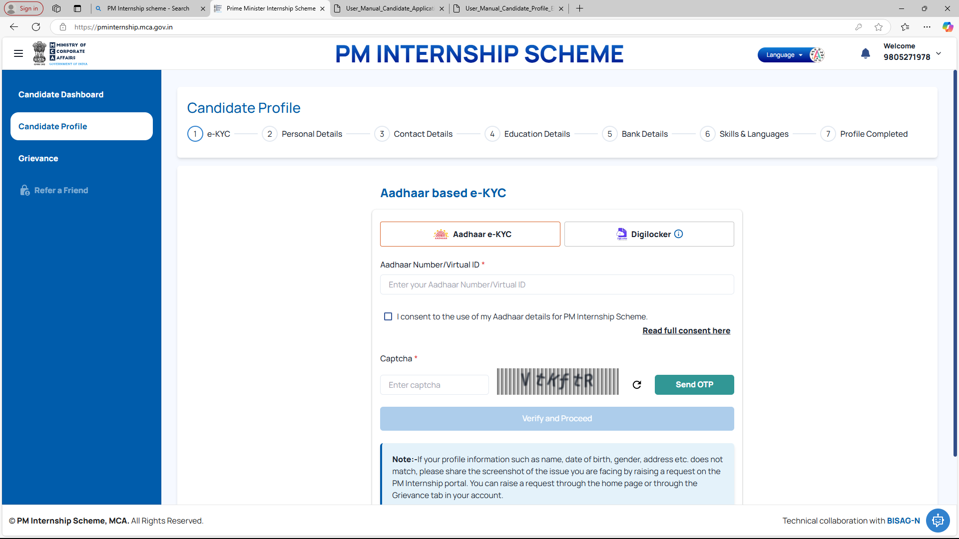
Complete the Profile

Slide 8
Thank you

